Slide 1


BIG DATA ARCHITECTURE AND GOVERNANCE
GROUP ASSIGNMENT - Data Analysis and Visualization
Group 8:
Litesh
Prerna
Kavin
Drishti

Slide 2

OVERVIEW
Dataset - Melbourne Airbnb Open Data
Describes listing activity of homestays in Melbourne, Australia
Melbourne was ranked 6th in the top 10 cities for Airbnb users globally in 2016
Image Source: The Australian

Slide 3

OBJECTIVES
To examine the dataset and clean the data
Select and install a NoSQL database to load the dataset
Connect the database to PowerBI to perform analysis -
In Scope | Out of Scope*
Trend of Airbnb users and listings Popular property types and neighborhoods Busiest times of the year to visit Melbourne Percentage/Proportion of super hosts Most/Least responsive hosts | Criteria for a host to be eligible to become a super host Sentiment analysis on the guest reviews using text analytics Vibe of each neighborhood using descriptions Correlations of the features of the listings
*Out of Scope – These are some of the possible outcomes of this project which are currently beyond the scope but can be achieved, provided we have some additional information

Slide 4
BUSINESS TERMS
Category | Description
Listing | The group of attributes that describe every property listed on the Airbnb website
Host | The group of attributes that contain information related to the person who creates a listing
Neighborhood | The group of attributes that define a district, especially one forming a community within a town or a city
Guest | The group of attributes with the information related to a person who makes a reservation
Reviews | The group of attributes that help in determining the ratings and feedback from the guests for a host and the listing

Slide 5












VISION DIAGRAM
Data Source
Data Ingestion
Data Destination
Calendar
Manual
Listings
Reviews
R-Programming
Listings Summary
Cassandra
PowerBI
ODBC Connector
Python
Data Storage
Data Analysis
Reviews Summary
Reporting/ Visualization
Neighborhoods
Data Cleaning

Slide 6
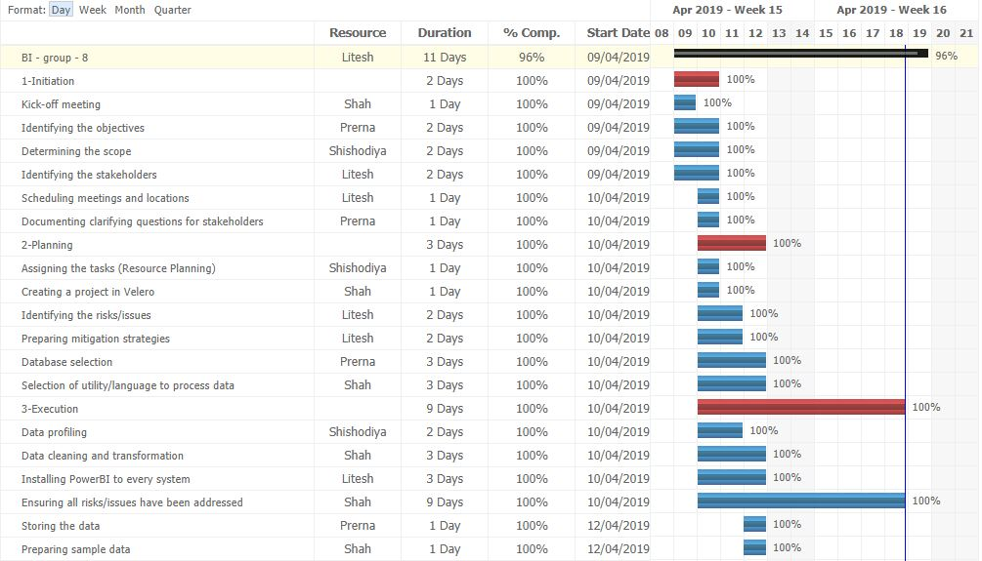
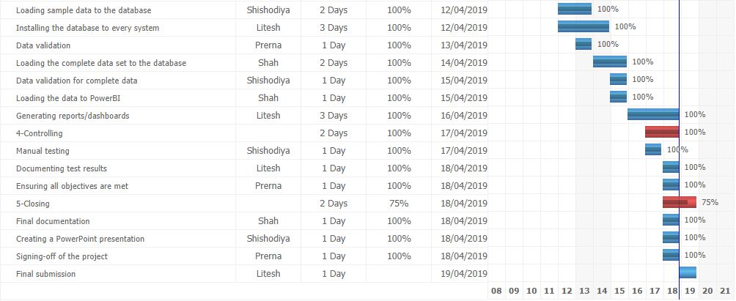
ACTION PLAN

Slide 7

DATABASE SELECTION
Research
Airbnb uses Presto as an Open Source distributed SQL query engine
Presto allows querying over data which is residing in databases like Cassandra, Hive
Dataset
Data originally stored in tables, rows and columns
Unique identifier for each row
Key Points
Cassandra is free, open source and compatible with PowerBI
Uses Cassandra Query Language (CQL), which is an alternative to the traditional SQL

Slide 8

DATA PREPARATION
MS Excel
Dropped redundant columns
Clubbed multiple sheets to a single sheet using VLOOKUP function
R-Programming
Replaced nulls in columns (with numeric data types) by average of the available values
Dropped columns with open text
Python
Renamed the columns based on information stored in the column
Validated the dataset to ensure there are no blanks

Slide 9
RISKS/ISSUES
Risk/Issue | Mitigation
Columns with open text fields | Removed the columns
Columns (Numeric) with Null values | Replaced Null values with the mean of available values
Columns (Text) with Null values | Removed the rows as Cassandra cannot handle N/A or Null values
Installing database to every system | Created a document with detailed instructions on each step
Duplicated columns | Dropped the columns that contained almost same information
Column names | Renamed the column names that align with the data stored in columns

Slide 10
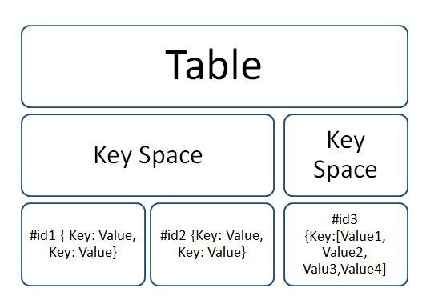

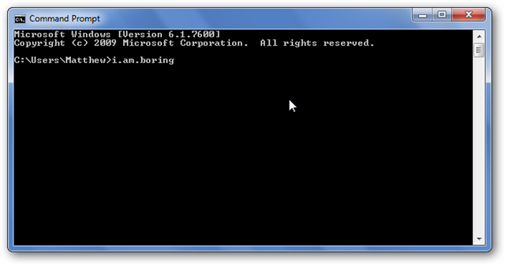


EXECUTION
Run Cassandra through Command Prompt
Describe keyspace (Analogous to database)
Create tables using query
Connect Cassandra to PowerBI using ODBC driver
Valid data using select query
Load data to Cassandra through .csv

Slide 11
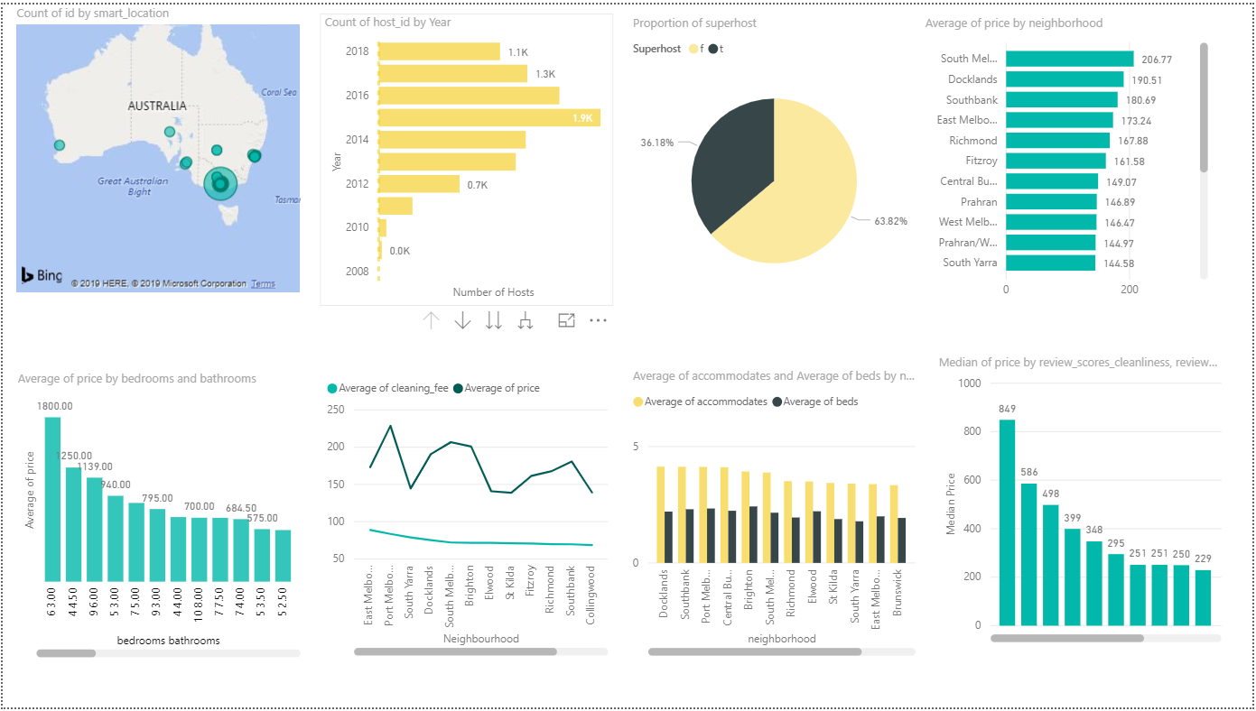
ANALYSIS

Slide 12
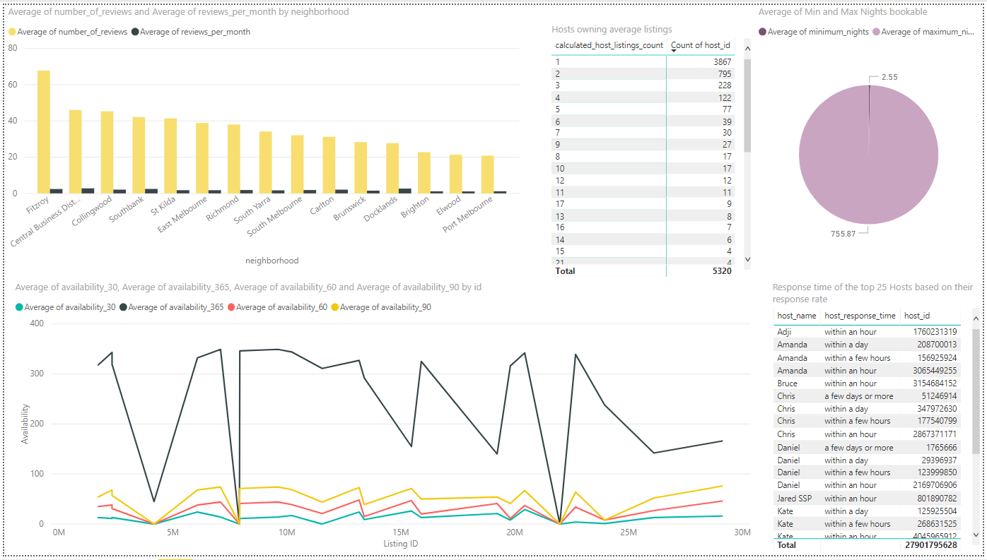
ANALYSIS

Slide 13
THANK YOU!
Any Questions?

